Slide 1


Servicii distribuite
Alocarea dinamică a resurselor de rețea pentru transferuri de date de mare viteză
folosind servicii distribuite
Distributed Services
Dynamic network resources allocation
for high performance transfers
using distributed services
Autor
Ing. Ramiro Voicu
Conducător ştiinţific
Prof. Dr. Ing. Nicolae Ţăpuş
- 2012-

Slide 2
Outline
Current challenges in data-intensive applications
Thesis objectives
Fundamental aspects of distributed systems
Distributed services for dynamic light-paths provisioning
MonALISA framework
FDT: Fast Data Transfer
Experimental result
Conclusions & Future Work

Slide 3
Data intensive applications: current challenges and possible solutions
Large amounts of data (in order of tens of PetaBytes) driven by R&E communities Bioinformatics, Astronomy and Astrophysics, High Energy Physics (HEP)
Both the data and the users, quite often geographically distributed
What is needed
  Powerful storage facilities
  High-speed hybrid network (100G around the corner); both packet based and circuit switching
    OTN paths, λ, OXC (Layer 1)
    EoS(VCG/VCAT) + LCAS (Layer 2)
    MPLS (Layer 2.5), GMPLS (?)
  Proficient data movement services with intelligent scheduling capabilities of storages, networks and data transfer applications

Slide 4
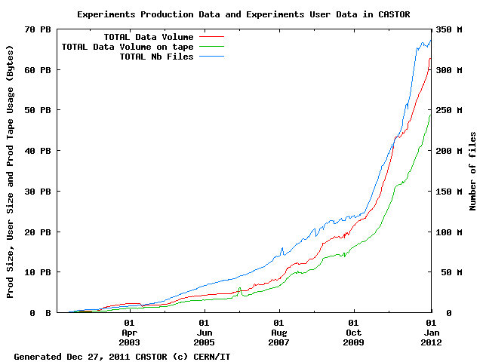
Challenges in data intensive applications
CERN storage manager CASTOR (Dec 2011):
60+ PB of data in ~350M files
Source: Castor statistics, CERN IT department, December 2011

Slide 5
DataGrid basic services
A. Chervenak, I. Foster, C. Kesselman, C. Salisbury, S. Tuecke, ”The Data Grid: Towards an Architecture for the Distributed Management and Analysis of Large Scientific Datasets”
Resource reservation and co-allocation mechanisms for both storage systems and other resources such as networks, to support the end-to-end performance guarantees required for predictable transfers
Performance measurements and estimation techniques for key resources involved in data grid operation, including storage systems, networks, and computers
Instrumentation services that enable the end-to-end instrumentation of storage transfers and other operations

Slide 6
Thesis objectives
This thesis studies and addresses key aspects of the problem of high performance data transfers
A proficient provisioning system for network resources at Layer1 (light-paths) which must be able to reroute the traffic in case of problems
An extensible monitoring infrastructure capable to provide full end-to-end performance data. The framework must be able to accommodate monitoring data from the whole stack: applications and operating systems, network resources, storage systems
A data transfer tool capable of dynamic bandwidth adjustments capabilities, which may be used by higher-level data transfer services whenever network scheduling is not possible

Slide 7
Fundamental aspects of distributed systems
Heterogeneity
  Undeniable characteristic (LAN, WAN - IP, 32/64bit – Java, .Net , Web Services)
Openness
  Resource-sharing through open interfaces (WSDL, IDL)
Transparency
  unabridged view to its user
Concurrency
  Synchronization on shared resources
Scalability
  Accommodate without major performance penalty an increase in requests load
Security
  Firewalls, ACLs, crypto cards, SSL/X.509, dynamic code loading
Fault tolerance
  deal with partial failures without significant performance penalty
  Redundancy and replication
  Availability and reliability
The entire work presented here is based on these aspects!

Slide 8
Provisioning System
A proficient provisioning system for network resources at Layer1 (light-paths) which must be able to reroute the traffic in case of problems
A data transfer tool capable of dynamic bandwidth adjustments capabilities, which may be used by higher-level data transfer services whenever network scheduling is not possible
An extensible monitoring infrastructure capable to provide full end-to-end performance data. The framework must be able to accommodate monitoring data from the whole stack: applications and operating systems, network resources, storage systems

Slide 9



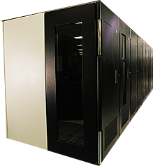
Simplified view of an optical network topology
The edges are pure optical links
  They may as well cross other network devices
Both simplex (e.g. video) and duplex devices are connected
H323
H323
Site A
Site B
Mass
Storage
System
MSS
Mass
Storage
System
MSS

Slide 10
Cross-connect inside an optical switch
An optical switch is able to perform the “cross-connect” function
Fiber₁ IN
Fiber₁ OUT
f₁IN
f₁OUT
Fiber₂ IN
Fiber₂ OUT
Fiber₃ IN
f₂IN
f₂OUT
FXC
Fiber₃ OUT
f₃IN
f₃OUT
Fiber_{n-1} IN
f_{n-1}OUT
Fiber_{n-1} OUT
f_{n-1}IN
Fiber_{n} IN
f_{n}IN
f_{n}OUT
Fiber_{n} OUT

Slide 11
Formal model for the network topology
H323
H323
Site A
Mass
Storage
System
Site B
MSS
Mass
Storage
System
MSS

Slide 12
Optical light path inside the topology
H323
H323
Site A
Mass
Storage
System
Site B
MSS
Mass
Storage
System
MSS

Slide 13
Important aspects of light paths in the multigraph
All optical paths in the FXC multigraph are edge-disjointed
H323
H323
Site A
Site B
Mass
Storage
System
MSS
Mass
Storage
System
MSS

Slide 14
Single source shortest path problem
Similar approach with the link-state routing protocols (IS-IS, OSPF)
Dijkstra’s algorithm combined with lemma’s results
  Edges involved in a light path are marked as unavailable for path computation
H323
3
1
H323
5
3
15
7
7
10
1
1
9
8
2
11
Site A
4
3
Site B
Mass
Storage
System
MSS
Mass
Storage
System
MSS

Slide 15
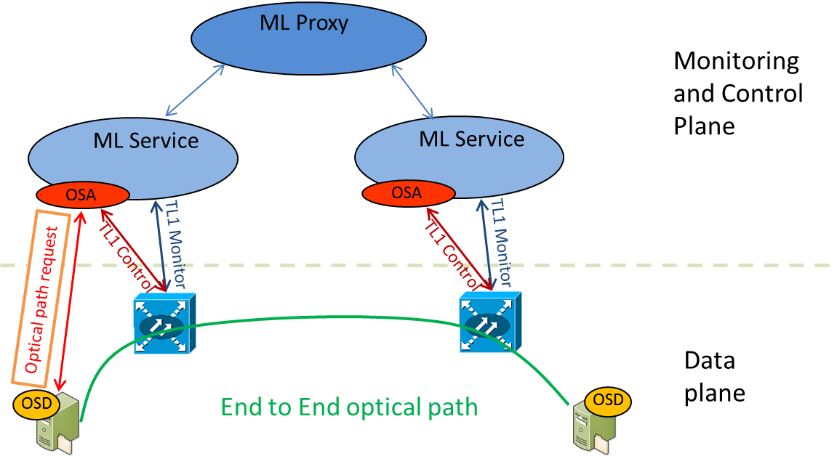
Simplified architecture of a distributed end-to-end optical path provisioning system
Monitoring, Controlling and Communication platform based on MonALISA
OSA – Optical Switch Agent
  runs inside the MonALISA Service
OSD – Optical Switch Daemon on the end-host

Slide 16
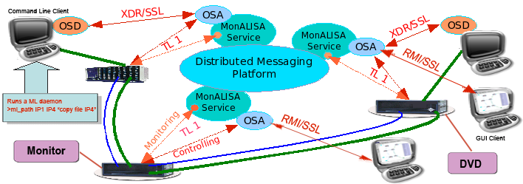
A more detailed diagram
http://monalisa.caltech.edu/monalisa__Service_Applications__Optical_Control_Planes.htm

Slide 17
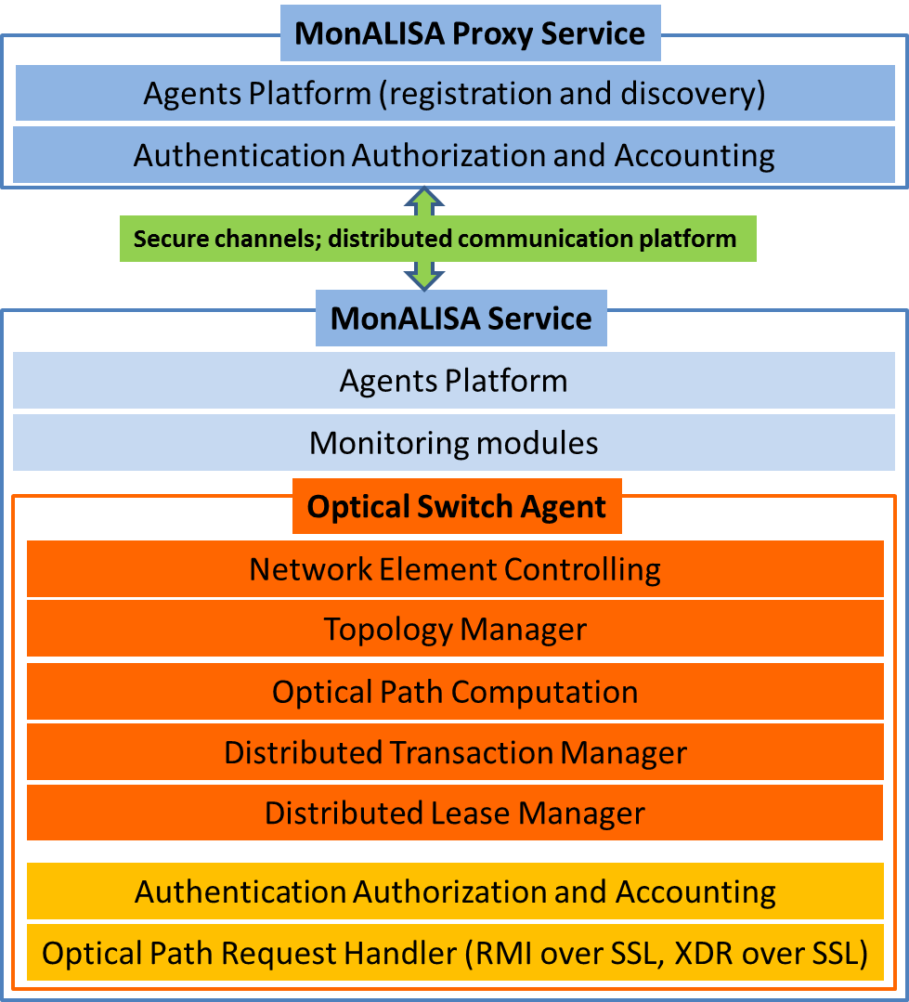
OSA: Optical Switch Agent components
Message based approach based on MonALISA infrastructure
NE Control
  TL1 cross-connects
Topology Manager
  Local view of the topology
  Listens for remote topology changes and propagates local changes
Optical Path Comp
  Algorithm implementation

Slide 18
OSA: Optical Switch Agent components(2)
Distributed Transaction Manager
  Distributed 2PC for path allocation
  All interactions are goverened by timeout mechanism
  Coordinator (OSA which received the request)
Distributed Lease Manager
  Once the path is allocated each resource get a lease; heartbeat approach

Slide 19
MonALISA: Monitoring Agents using a Large Integrated Service Architecture
A proficient provisioning system for network resources at Layer1 (light-paths) which must be able to reroute the traffic in case of problems
An extensible monitoring infrastructure capable to provide full end-to-end performance data. The framework must be able to accommodate monitoring data from the whole stack: applications and operating systems, network resources, storage systems
A data transfer tool capable of dynamic bandwidth adjustments capabilities, which may be used by higher-level data transfer services whenever network scheduling is not possible

Slide 20

MonALISA architecture
Higher-Level Services & Clients
Regional or Global High Level Services,
Repositories & Clients
Secure and reliable communication
Dynamic load balancing
Scalability & Replication
AAA for Clients
Agents lookup & discovery
Proxy
Services
Information gathering and:
Customized aggregation, Filters,
Agents
Agents
MonALISA Services
Discovery and Registration
based on a lease
mechanism
JINI-Lookup Services Secure & Public
Fully Distributed System with NO Single Point of Failure

Slide 21
MonALISA implementation challenges
Major challenges towards a stable and reliable platform were I/O related (disk and network)
Network perspective: “The Eight Fallacies of Distributed Computing”
- Peter Deutsch, James Gosling
  The network is reliable
  Latency is zero
  Bandwidth is infinite
  The network is secure
  Topology doesn't change
  There is one administrator
  Transport cost is zero
  The network is homogeneous
Disk I/O – distributed network file systems, silent errors, responsiveness

Slide 22
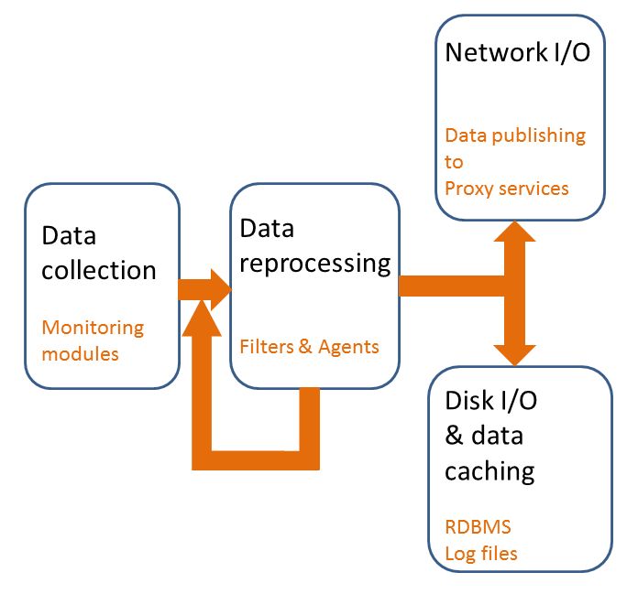
Addressing challenges
All remote calls are asynchronous and with an associated timeout
All interaction between components intermediated by queues served by 1 or more thread pools
I/O MAY fail; the most challenging are silent failures; use watchdogs for blocking I/O

Slide 23
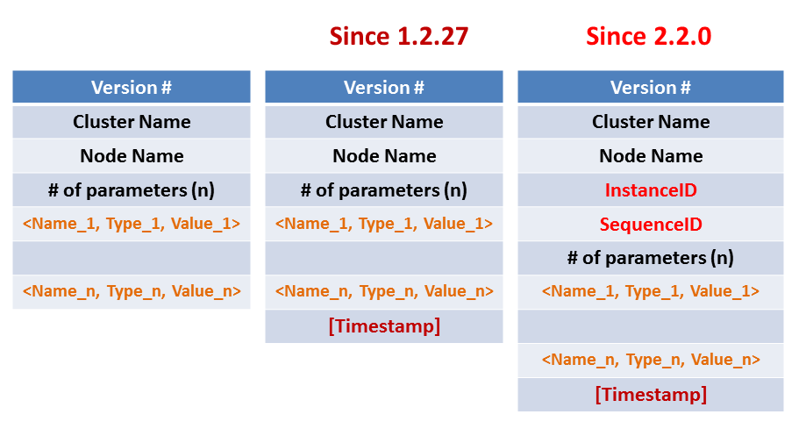
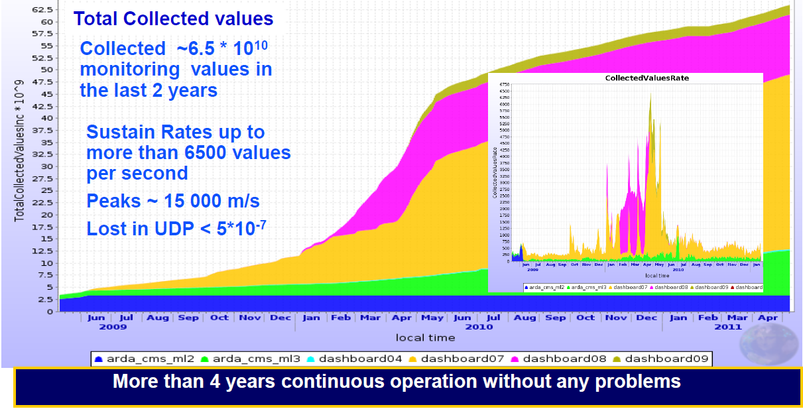
ApMon: Application Monitoring
Light-weight library for application instrumentation to publish data into MonALISA
UDP based
XDR encoded
Simple API provided for: Java, C/C++, Perl, Python
Easily evolving
Initial goal : job instrumentation in CMS (CERN experiment) to detect memory leaks
Provides also full host monitoring in a separate thread (if enabled)

Slide 24
MonALISA – short summary of features
The MonALISA package includes:
  Local host monitoring (CPU, memory, network traffic , Disk I/O, processes and sockets in each state, LM sensors), log files tailing
  SNMP generic & specific modules
  Condor, PBS, LSF and SGE (accounting & host monitoring), Ganglia
  Ping, tracepath, traceroute, pathload and other network-related measurements
  TL1, Network devices, Ciena, Optical switches
  XDR-formatted UDP messages (ApMon).
New modules can be easily added by implementing a simple Java interface, or calling external script
Agents and filters can be used to correlate, collaborate and generate new aggregate data

Slide 25
MonALISA Today
Running 24 X 7 at ~360 Sites
Collecting ~ 3 million “persistent” parameters in real-time
80 million “volatile” parameters per day
Update rate of ~35,000 parameter updates/sec
Monitoring
  40,000 computers
  > 100 WAN Links
  > 8,000 complete end-to-end
  network path measurements
  Tens of Thousands of Grid jobs
  running concurrently
Controls jobs summation, different central services for the Grid, EVO topology, FDT …
The MonALISA repository system serves
~8 million user requests per year.
10 years since project started (Nov 2011)

Slide 26
FDT: Fast Data Transfer
A proficient provisioning system for network resources at Layer1 (light-paths) which must be able to reroute the traffic in case of problems
An extensible monitoring infrastructure capable to provide full end-to-end performance data. The framework must be able to accommodate monitoring data from the whole stack: applications and operating systems, network resources, storage systems
A data transfer tool capable of dynamic bandwidth adjustments capabilities, which may be used by higher-level data transfer services whenever network scheduling is not possible

Slide 27
FDT client/server interaction
Control connection / authorization
NIO Direct buffers
Native OS operation
NIO Direct buffers
Native OS operation
Data Channels / Sockets
Restore the files from
buffers
Independent
threads per device

Slide 28
FDT features
Out-of-the-box high performance using standard TCP over multiple streams/sockets
Written in Java; runs on all major platforms
Single jar file (~800 KB)
No extra requirements other than Java 6
Flexible security
  IP filter & SSH built-in
  Globus-GSI, GSI-SSH external libraries needed in the CLASSPATH; support is built-in
Pluggable file systems “providers” (e.g. non-POSIX FS)
Dynamic bandwidth capping (can be controlled by LISA and MonALISA)

Slide 29
FDT features (2)
Different transport strategies:
  blocking (1 thread per channel)
  non-blocking (selector + pool of threads)
On the fly MD5 checksum on the reader side
  On the writer side MUST be done after data is flushed to the storage (no need for BTRFS and ZFS ?)
Configurable number of streams and threads per physical device (useful for distributed FS)
Automatic updates
User defined loadable modules for Pre and Post Processing to provide support for dedicated Mass Storage system, compression, dynamic circuit setup, …
Can be used as network testing tool (/dev/zero → /dev/null memory transfers, or –nettest flag)

Slide 30
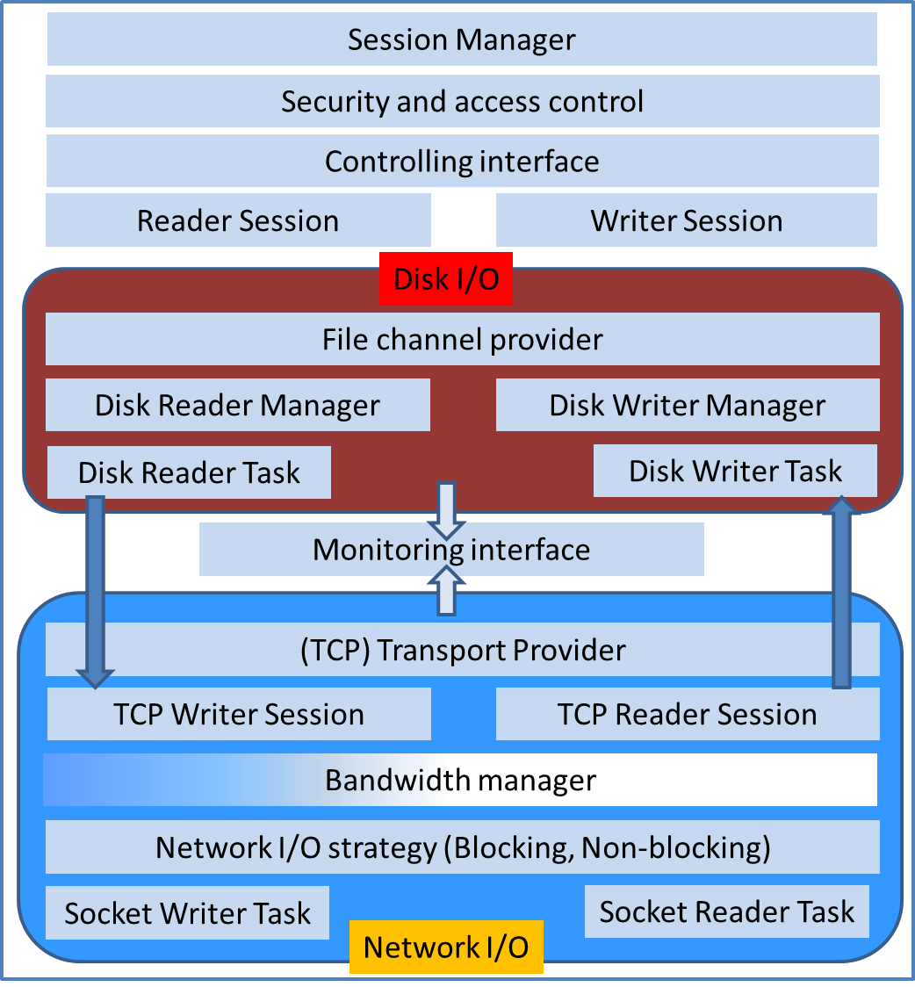
Major FDT components
Session
  Security
  External control
Disk I/O
  FileBlock Queue
Network I/O

Slide 31
Session Manager
Session bootstrap
CLI parsing
Initiates the control channel
Associates an UUID to the session & files
Security & access
  IP filter
  SSH
  Globus-GSI
  GSI-SSH
Ctrl interface
  HL Services
  MonA(LISA)

Slide 32
Disk I/O
FS provider
  POSIX (embedded)
  Hadoop (external)
Physical partition identification
Each partition gets a pool of threads
  one thread for normal devices
  Multiple threads for distributed network FS
Builds the FileBlock
(UUID session, UUID file, offset, data length)
Mon interface
  ratio % = Disk time / Time Wait Q Net

Slide 33
Network I/O
Shared Queue with Disk I/O
Mon interface
  Per channel throughput
  ratio % = net time / time Q wait disk
BW manager
  Token based approach on the writer side
  rateLimit * (currentTime – lastExecution)
I/O strategies
  BIO – 1 thread per data stream
  NBIO – event based pool of threads (scalable but issues on older Linux kernels…)

Slide 34
Experimental results

Slide 35
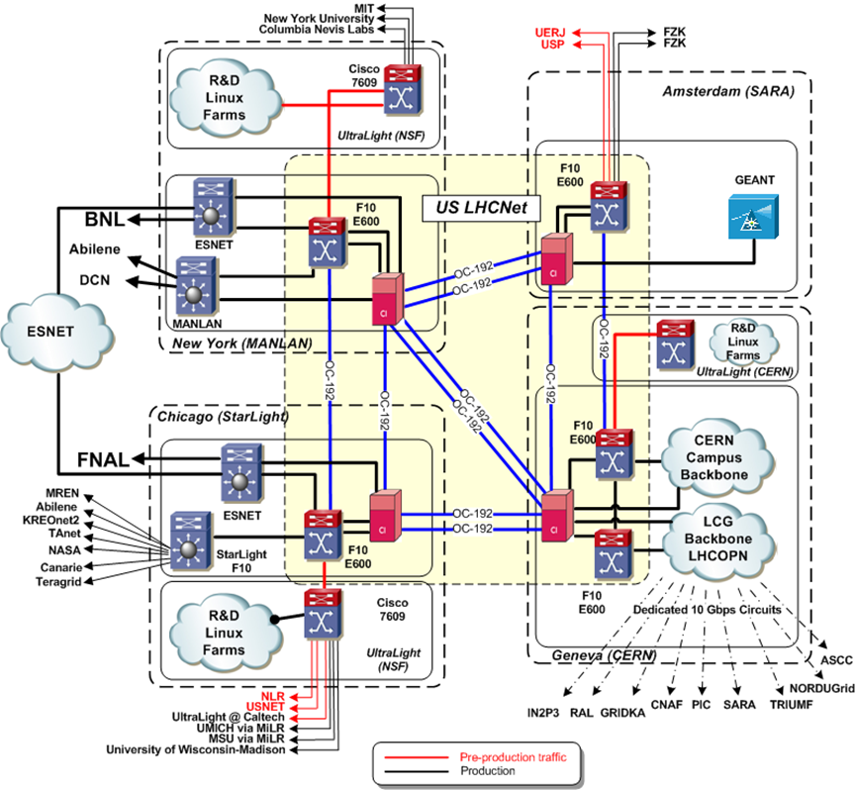
USLHCNet: High-speed trans-Atlantic network
CERN to US
  FNAL
  BNL
6 x 10G links
4 PoPs
  Geneva
  Amsterdam
  Chicago
  New York
The core is based on Ciena CD/CI (Layer 1.5)
Virtual Circuits

Slide 36
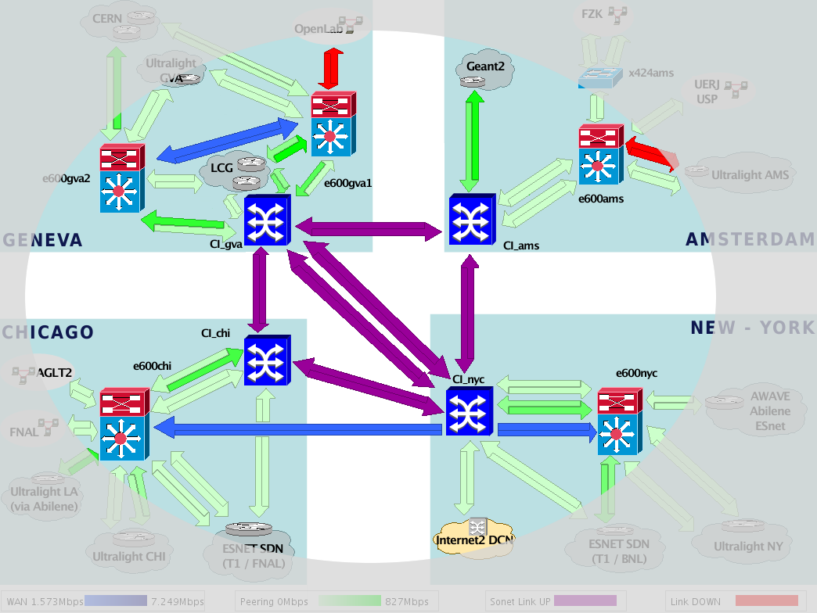
USLHCNet distributed monitoring architecture
MonALISA
@GVA
MonALISA
@AMS
Each Circuit
is monitored at both
ends by at least two
MonALISA services;
the monitored data
is aggregated by
global filters in
the repository
MonALISA
@CHI
MonALISA
@NYC

Slide 37
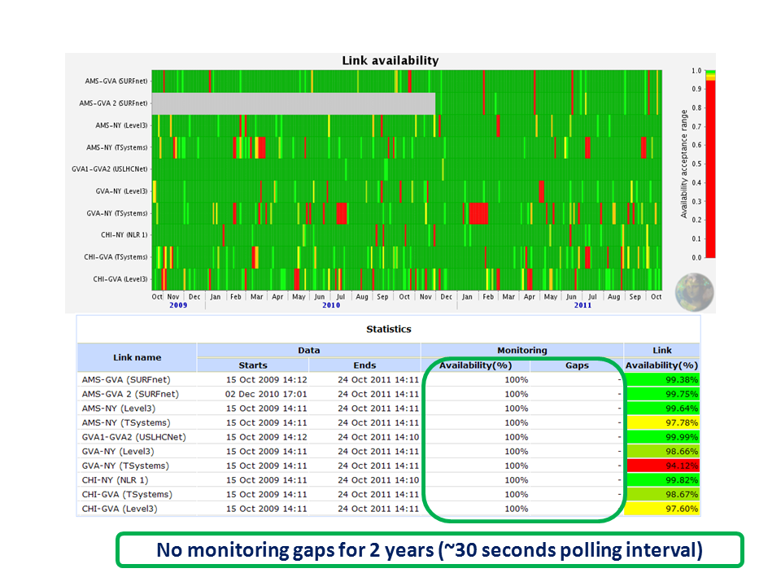
High availability for link status data
The second link from the top AMS-GVA 2(SURFnet) was commissioned Dec 2010

Slide 38
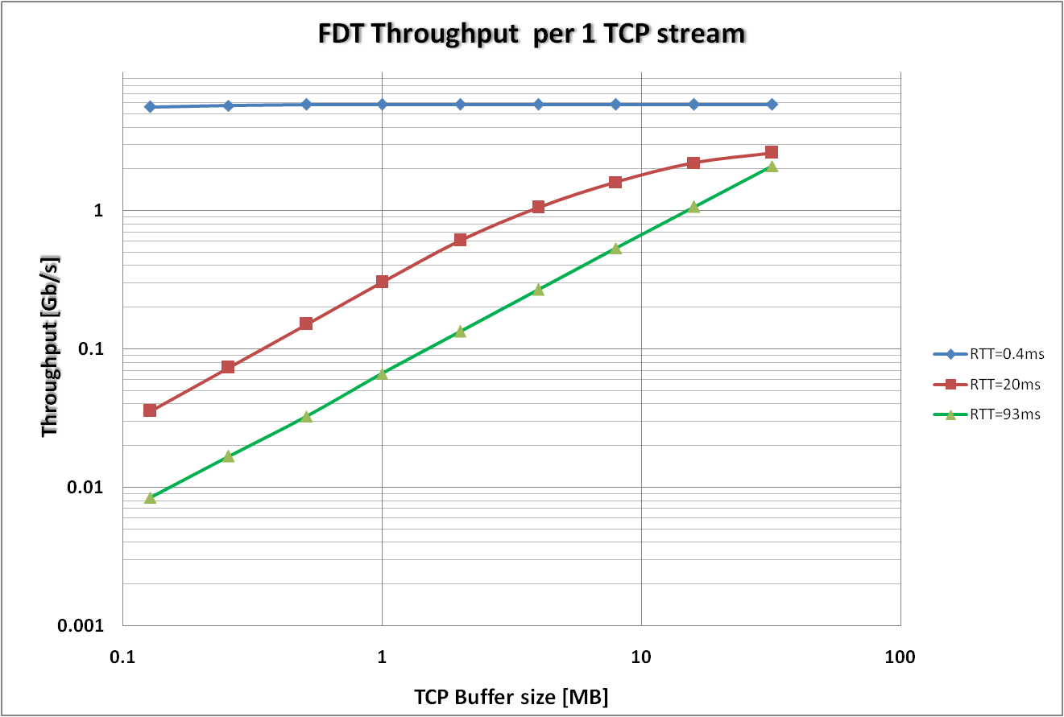
FDT Throughput tests – 1 Stream

Slide 39
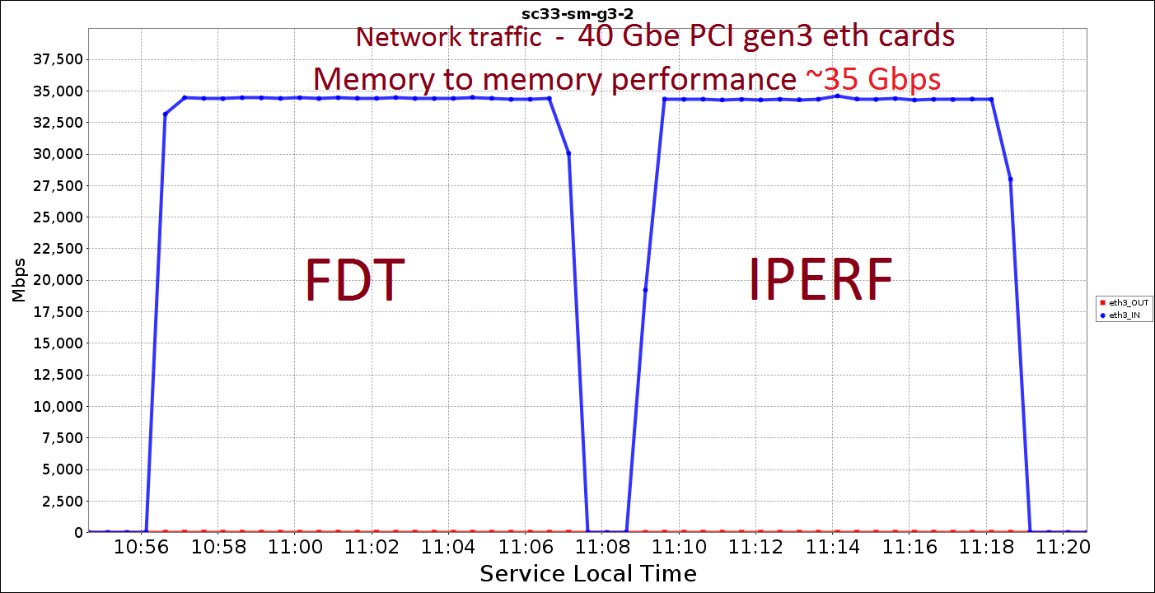
FDT: Local Area Network Memory to Memory performance tests
Most recent tests from SuperComputing 2011
Same performance as IPERF

Slide 40
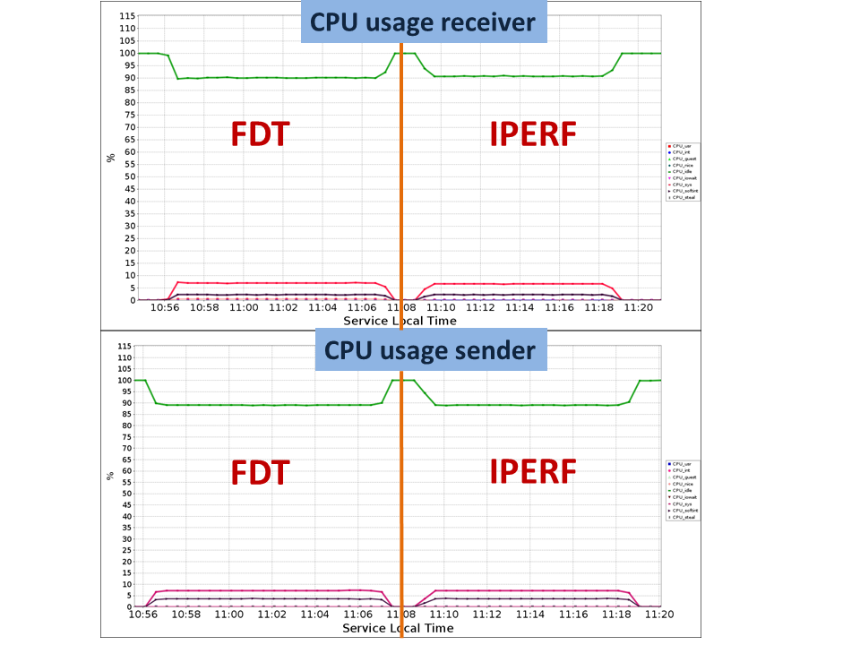
FDT: Local Area Network Memory to Memory performance tests
Same CPU usage

Slide 41
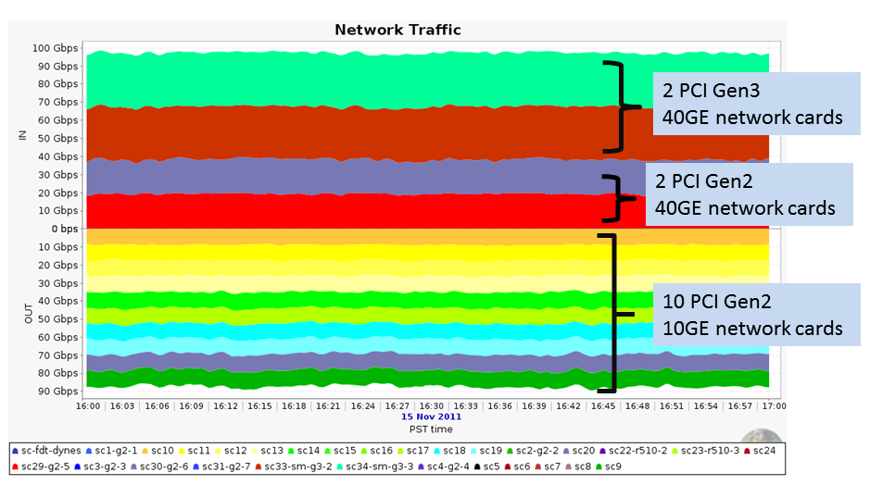
WAN test over an OUT-4 (100 Gbps) link @ SC11

Slide 42
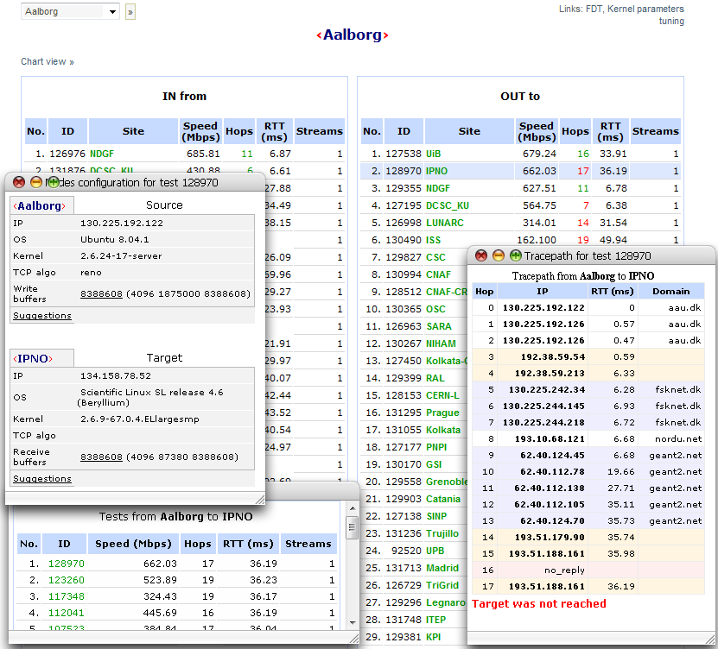
Active End to End Available Bandwidth between all the ALICE grid sites

Slide 43
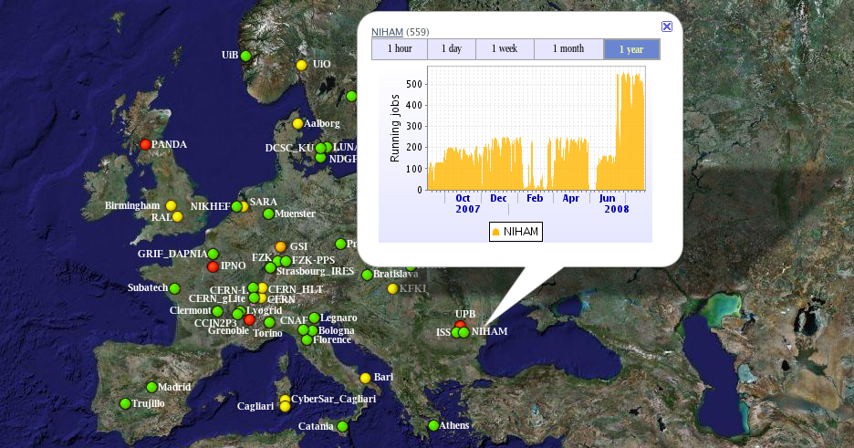
ALICE : Global Views, Status & Jobs

Slide 44
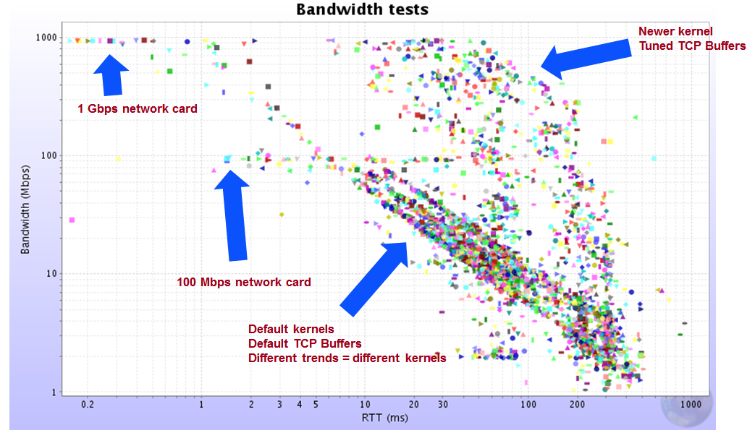
Active End to End Available Bandwidth between all the ALICE grid sites with FDT

Slide 45
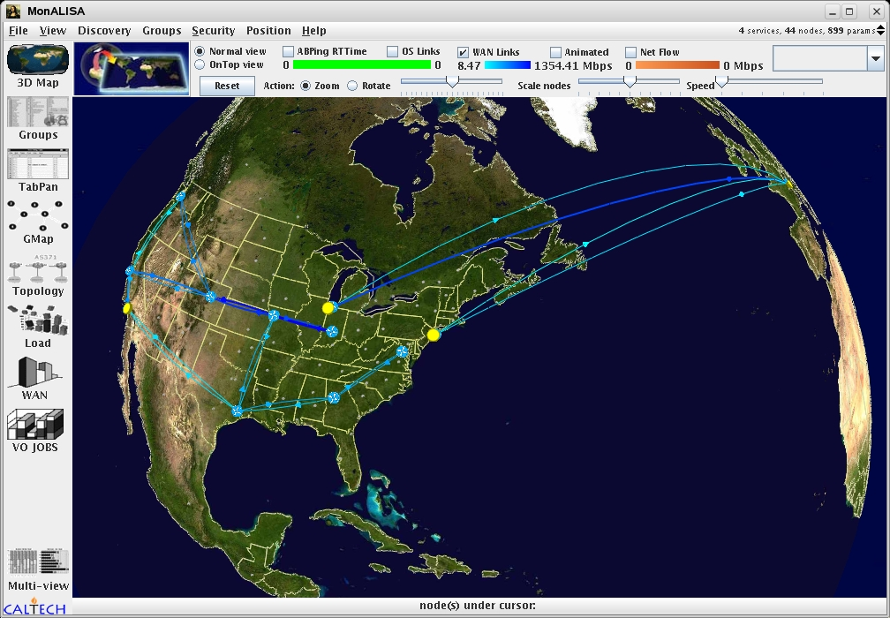
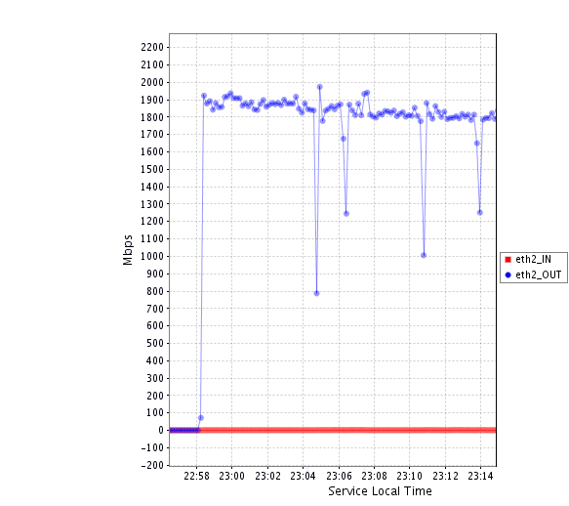
Controlling Optical Planes
Automatic Path Recovery
200+ MBytes/sec
From a 1U Node
CERN
Geneva
USLHCNet
Internet2
StarLight
FDT Transfer
CALTECH
Pasadena
MAN LAN
“Fiber cut” emulations
The traffic moves from one
transatlantic line to the other one
FDT transfer (CERN – CALTECH)
continues uninterrupted
TCP fully recovers in ~ 20s
4
2
3
1
4 fiber cut emulations

Slide 46
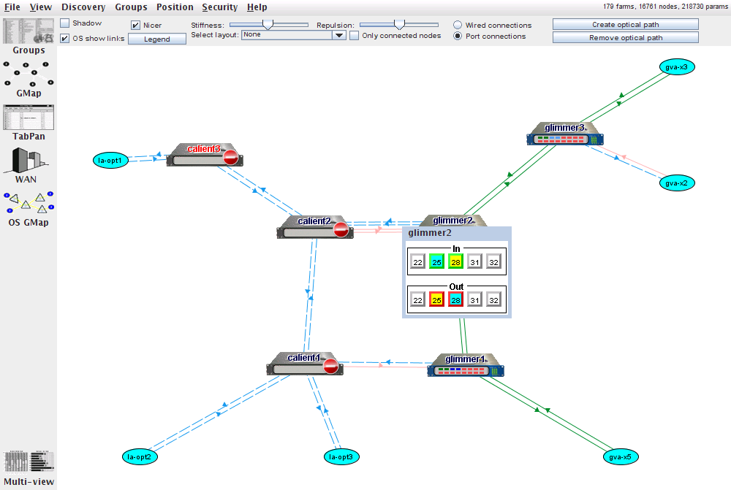
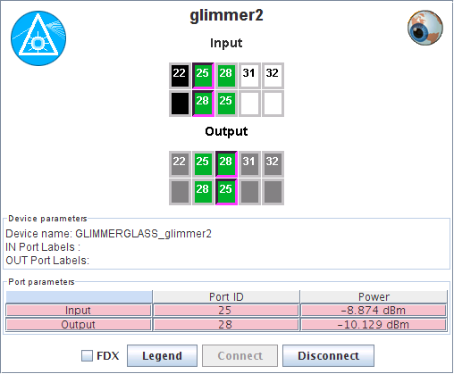
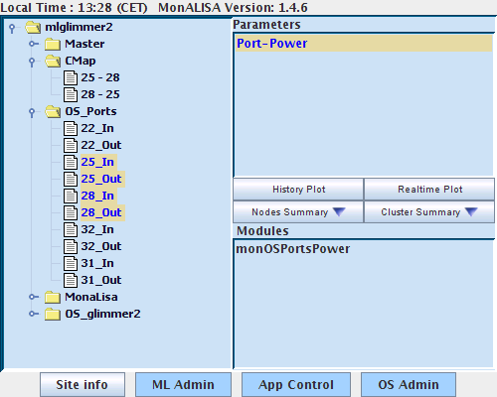
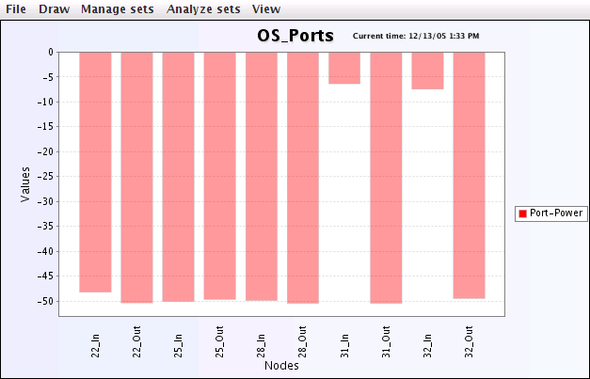
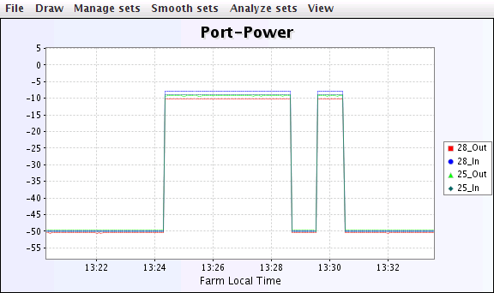
Real-time monitoring and controlling in the MonALISA GUI Client
Controlling
Port power monitoring
Glimmerglass Switch Example
46

Slide 47
Future work
For the network provisioning system: possibility to integrate OpenFlow-enabled devices
FDT: new features from Java7 platform like asynchronous I/O, new file system provider
MonALISA: routing algorithm for optimal paths within the proxy layer.

Slide 48
Conclusions
The challenge of data-intensive applications must be addressed from an end-to-end perspective, which includes: end-host/storage systems, networks and data transfer and management tools.
A key aspect is represented by a proficient monitoring which must provide the necessary feedback to higher-level services
The data services should augment current network capabilities for a proficient data movement
Data transfer tools should provide the dynamic bandwidth adjustments capabilities whenever networks cannot provide this feature

Slide 49
Contributions
Design and implementation of a new distributed provisioning system
  Parallel provisioning
  No central entity
  Distributed transaction and lease manager
  Automatic path rerouting in case of LOF (Loss of Light)
Overall design and system architecture for MonALISA system
  Addressed concurrency, scalability and reliability
  Monitoring modules for full host-monitoring (CPU, disk, network, memory, processes,
  Monitoring modules for telecom devices (TL1): optical switches (Glimmerglass & Calient), Ciena Core Director
  Design for ApMon and initial receiver module implementation
  Design and implementation of a generic update mechanism (multi-thread, multi-stream, crypto hashes)

Slide 50
Contributions (2)
Designed and main developer of FDT a high-performance data transfer with dynamic bandwidth capping capabilities
  Successfully used during several rounds of SC
  Fully integrated with the provisioning system
  Integrated with Higher-level services like LISA and MonALISA
Results published in articles at international conferences
Member of the team who won the Innovation Award from CENIC in 2006 and 2008, and the SuperComputing Bandwidth Challenge in 2009

Slide 51

Vă mulțumesc!
http://cern.ch/ramiro/thesis

